Slide 1
Membership Benefits You
Explore the many benefits of ISPE Student Membership

Slide 2

What is ISPE?
ISPE, the International Society for Pharmaceutical Engineering, is the world’s largest not-for-profit association serving its members by leading scientific, technical, and regulatory advancement throughout the entire pharmaceutical lifecycle.
ISPE is committed to the advancement of the educational and technical knowledge of its members through forums for the exchange of ideas and practical experience.

Slide 3
Students Succeed with ISPE
“As a student, being in an ISPE chapter has been a wonderful experience, personally as well as professionally. It was great to interact with young professionals and pioneers in the global pharmaceutical industry during ISPE’s 2017 Annual Meeting. I learned so much.” Himanshu Kathuria, Student, National University of Singapore
“Since joining ISPE as an undergraduate student almost ten years ago, I have had many opportunities to stay actively involved in ISPE by volunteering with my local chapter and at the international level, allowing me to learn about all aspects of the industry and develop my network around the world.” Jennifer Duffy, Senior Engineer/Shire Pharmaceuticals, Boston, MA
“I got involved with ISPE in 6th grade through a STEM school project and now I’m the Chapter president. ISPE has definitely played a positive role in my career.” Danielle Vassalotti-Rebori – Senior Associate, JacobsWyper Architects
“I started as an undergrad student. The connections I made through ISPE helped me get both my first and second jobs.” Brody Stara, Senior Consultant, Ernst & Young
“If I could describe my experience at the ISPE Poster Competition in three words, they would be: exhilarating, engaging, and enlightening.” Kinza Hussain, Student Member, MCPHS University
“ISPE has been, and continues to be, a great way to start my career.” Pelda Erpolat, Fourth-year Student at the Istanbul University Faculty of Pharmacy Student Chapter President with ISPE Turkey Affiliate Student Chapter
“As a student, I received a sponsorship to go to the ISPE Annual Meeting. There I met my mentor, who is still with me 10 years later.” Tiffany Coleman, IYPC Regional Leader, Lilu’s Garden

Slide 4
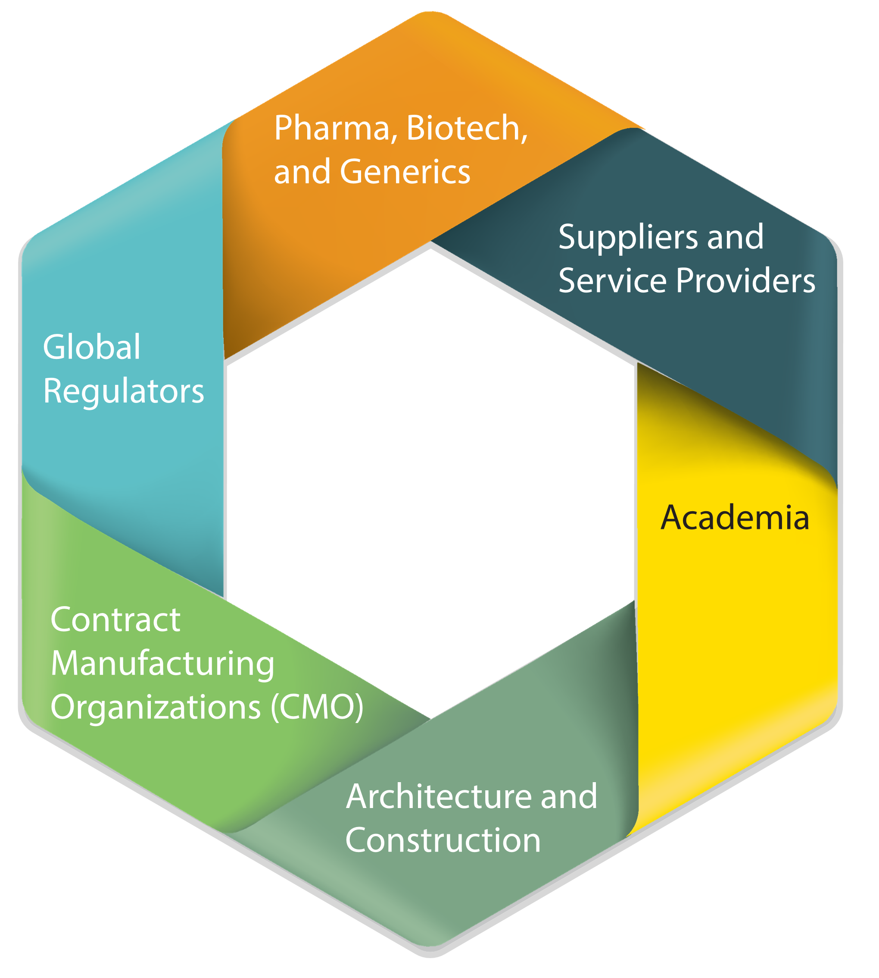
ISPE is Your Best Professional Advantage
Members represent all facets of the pharmaceutical industry. From design and construction to manufacturing of pharmaceutical products and medical devices, our members come from industries that include:
  Pharma and Biotechnology
  Contract Manufacturing Organizations (CMO)
  Architecture and Construction
  Suppliers and Service Providers
  Generics
  Global Regulators
  Academia

Slide 5
Network Locally and Globally
ISPE Affiliates (International) and Chapters (US) offer significant opportunities to connect with colleagues at home and around the globe.
  Establish and maintain personal and professional relationships, in your region and abroad, with like-minded industry professionals.
  Make critical connections with industry leaders that mentor, train, and discuss issues of mutual importance.
  ISPE has more than 18,000 members worldwide in more than 90 countries, with 38 Affiliates and Chapters.
“It's not who you know, it's who knows
you—join ISPE and get known!”
— Andre Walker, Principal, Andre Walker Consulting

Slide 6

Give and Receive Great Advice
Join a members-only online Community of Practice (CoP) to ask questions, learn new ideas, and share your expertise.
Active Pharmaceutical Ingredients
Biotechnology
Commissioning and Qualification
Containment
Critical Utilities
Disposables
GAMP®
HVAC
Investigational Products
Operations Management
Oral Solid Dosage
Packaging
Process Analytical Technology and Lifecycle Control Strategy
Process/Product Development
Project Management
Sterile Products Processing
“Connections, resources and information galore! Everyone I’ve ever met through ISPE is willing to share what they know and who they know.”
— Caren Jenkins, Marketing Manager,
B&V Testing/Certco

Slide 7

A Directory of Your Peers
Find members, nearby or around the world, in the ISPE Member Directory:
  Enhance your networking efforts by obtaining access to 18,000+ ISPE Affiliate and Chapter members located locally and internationally.
  Be part of a coveted, members-only list that enables members to be introduced to one another, communicate, and build relationships with like-minded industry professionals at all levels of experience.
  Support your professional endeavors – business or career opportunities – by utilizing this significant source of information.
“ISPE has given me the opportunity to meet people I would never have met – other ISPE members with decades of industry experience who have been willing to talk with me, mentor me, and help me in my studies and now, in my career.”
— Tony Le, Validation Engineer, CAI

Slide 8
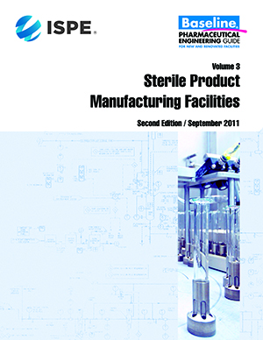
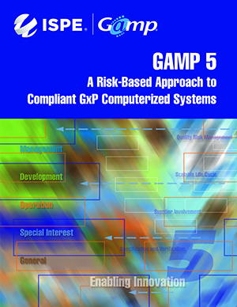

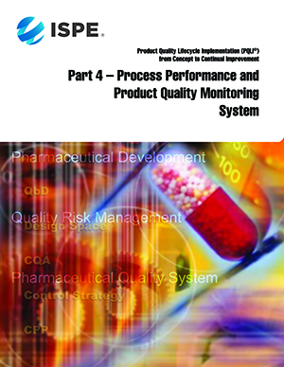
ISPE Guidance Documents = Best Practices
ISPE Guidance Documents are the “gold standard” in the industry. Members receive discounts on:
Baseline® Guides
GAMP® 5 and GAMP® Good Practice Guides
Good Practice Guides (free online access to all members!)
Product Quality Lifecycle Implementation®
(PQLI®) Guides
“Surrounding ourselves with “the best of the best” resources is paramount to achieving predictable outcomes. ISPE is the conduit to access great resources!”
— Kevin M. Chronley, VP, Strategic Planning and Development, A-Z Corp

Slide 9


ISPE Good Practice Guides… FREE!
Our library of 24 ISPE Good Practice Guides are available FREE to all members via the ISPE Guidance Document Portal. They include:
  Heating, Ventilation, and Air Conditioning (HVAC)
  Packaging, Labeling, and Warehousing Facilities
  Sampling Pharma Water, Steam, and Process Gases
  Decommissioning Pharma Equipment and Facilities
https://guidance-docs.ISPE.org
Currently excludes GAMP® and Baseline® Guides

Slide 10
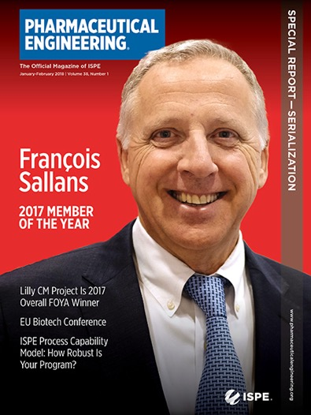

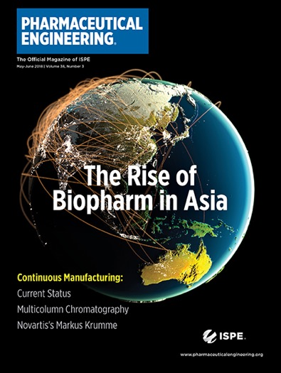

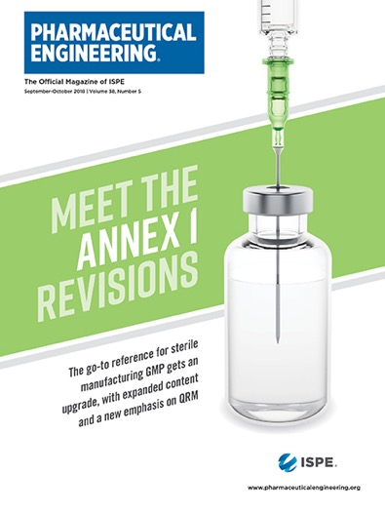
Pharmaceutical Engineering®
Your News Source
Pharmaceutical Engineering® is ISPE’s bi-monthly magazine presenting valuable information on the latest scientific and technical developments and regulatory initiatives. It also offers innovative solutions to real-life problems and challenges through practical application articles and case studies.

Slide 11

A Seat at the Table with Regulators
ISPE builds effective partnerships with regulators and agencies globally to ensure all members have access to the latest regulatory developments and expectations. ISPE members have the opportunity to review and provide input to health authorities on draft regulations and guidances. Our members are clarifying issues and advancing:
  Expedited Programs
  Continuous Manufacturing
  Knowledge Management
  Lifecyle Approach to Process Validation
  Process Robustness
  Quality Metrics
  Drug Shortages
  Patient-Centric Specification
  Product Quality Lifecycle Implementation® (PQLI)

Slide 12




Conferences and Workshops
Develop Your Skills
Network and problem-solve with top pharmaceutical and biopharmaceutical industry figures, earn Continuing Education Credits, learn about important industry topics, meet with suppliers, and share best practices with colleagues at ISPE Conferences, such as:
  ISPE Annual Meeting & Expo
  ISPE Europe Annual Conference
  Aseptic Conference
  Biopharmaceutical Manufacturing Conference
  And more…
  “We honestly enjoy every single event that ISPE has because, year-over year it’s given us double-digit growth and more presence in the pharmaceutical market.”
  — Andrew Lamore, Field Segment Manager, NA, Burkert Fluid Control Systems

Slide 13

Targeted, Topical Training for In-Depth Learning
ISPE offers continuing education opportunities almost every day of the year. Focused training at our headquarters in North Bethesda, MD, locally in your region, at your company, or around the world, there are hundreds of programs to keep you learning and growing in your career. Course topics include:
  Cleaning
  Commissioning
  and Qualification
  Facilities
  GAMP®
  GMPs
  HVAC
Manufacturing
Project Management
Quality by Design
Validation
Water
“I’ve met people from around the world, I’ve participated in training, and I’ve learned that ISPE sets the standard at all of the places I’ve worked.”
— Tiffany Coleman, IYPC Regional Leader, Lilu’s Garden

Slide 14

Online Learning – Available Anytime, Anywhere
eLearning Expanded Courses offer ISPE’s signature training – the type usually delivered over two to three days in a distant classroom – from your home or office.
General Industry Knowledge Courses provides general knowledge while giving an industry overview, historical background, and the basic building blocks to get you started.
Fundamental Industry Knowledge Courses are ISPE’s pre-recorded courses, developed and reviewed by expert instructors and international regulatory advisors.
GMP Courses teach the US Food and Drug Administration’s Systems-based GMP Inspection Approach
“It is very convenient to be able to learn at your desk, at your own pace, using ISPE e-learning courses.”
— Bernadette De Leye, Project Manager,
STEXCON, Haasrode Belgium

Slide 15

Career Solutions When Job Hunting or Hiring
If you are looking for the best talent, or searching for the best place to work, ISPE’s online job bank is the place to go.
Job Seekers:
  Post your resume for visibility to hiring managers.
  Search jobs to find the perfect position.
  Set up a job alert to ensure you don’t miss any relevant job postings.
Hiring Managers:
  Search for talented professionals.
  Post jobs to reach your next great employee.
“Being an ISPE member helped me get the job I currently have, which is huge!”
— Tony Le, Validation Engineer, CIA

Slide 16

Get Involved and Get Inspired –
Volunteer for ISPE
Volunteering is beneficial to both you and the Society. Help others grow professionally, participate in shaping the organization, and give back to the industry. Examples include:
  Speaking at an ISPE Conference
  Contributing content to Pharmaceutical Engineering® Magazine
  Authoring, editing, or reviewing technical documents
  Participating in Communities of Practice (CoPs)
  Becoming a chapter leader at a local college or university
  Participating in local affiliate or chapter events
  Mentoring students and Young Professionals
  Volunteering for short, focused ad hoc projects
“We have great opportunities to take a risk, or make a new friend, who one day may become our colleague, boss, or client. You never know when you are going to bring value to someone, but if you are not out there trying, you will never know how important your assets can be to someone.”
— Jennifer Clark, CPIP, CIA; ISPE Women in Pharma

Slide 17

Empowering Women and Increasing Diversity
“ISPE has helped me foster personal as well as professional relationships, and I’ve met amazing industry influencers.”
— Danielle Vassalotti-Rebori, Senior Associate,
Jacobs/Wyber Architects
ISPE Women in Pharma® (WIP) provides women in the pharmaceutical industry a forum for connecting and collaborating on technical and career advancement topics. Women in Pharma’s inclusive community leverages a network of mentors, role models, and resources across all levels to foster balanced professional success.
Connect with WIP members at ISPE events, such as:
  Breakfast panel discussion sessions
  Education sessions focused on professional development
  WIP Networking Events
  Informal meetups
  Local Affiliate and Chapter events
  Mentor Circles

Slide 18

Giving Back: The ISPE Foundation
The ISPE Foundation addresses new and evolving
industry demands by supporting a dynamic range of
new mission-related initiatives to create opportunity,
equality, and success for the global pharmaceutical
industry through programs including:
  Building the Workforce for the Future – attracting, educating, and training talented students and Young Professionals by providing financial support to further their professional development through the ISPE Travel Grant Program.
  Empowering Women and Increasing Diversity – providing professional training and education, fostering mentorship and networking for women and ethnically diverse people, and driving the successful career progression of under-represented groups within our industry.
  Global Knowledge Management – making ISPE’s highly regarded industry Guides available to emerging markets through the Emerging Markets Knowledge Exchange, and training global regulators in industry best practices through the Global Training and Harmonization Fund.

Slide 19
ISPE Students and Young Professionals –
The Future of the Industry
Still in school or just graduated? Join ISPE!
  Student Members – $29/€29
  Individuals enrolled full-time at a college, university, or other academic institution; while in school and for one year following graduation.
  Emerging Economy Students – $10/€10
  Individual students residing in an emerging economy country receive discounted dues.
  Young Professional Members – $121/€107
  Individuals starting in the industry, for up to five years after graduation.
  Emerging EconomyYoung Professional Members – $62/€55
  Individuals residing in an emerging economy country and starting in the industry receive discounts for up to five years after graduation.
“I started as an undergrad student. The connections I made through ISPE were the people who recommended me for interviews for all of my previous and current roles.”
— Brody Stara, Senior Consultant, Ernst & Young

Slide 20

Student and Young Professional Activities
Get to know your local Affiliate or Chapter so you can attend:
  Social activities, such as happy hours, bowling, or local networking events
  Educational activities, such as educational and training sessions, soft-skill facilitation, workshops, industry guest speakers, annual Hackathons, and tours of industry facilities
  Career development activities, such as mentorship programs, interactions with industry professionals, ISPE conference attendance, scholarship opportunities, and more
  Participation in local and international competitions, including presenting your work at the ISPE Annual Meeting
“I joined in university and gained technical knowledge by attending ISPE seminars. Because of those seminars, I got my first job and now I’m a committee chair!”
— Rachel Anne (Raine) Fernandez, ISPE Philippines Affiliate

Slide 21
Join a Student Chapter Near You
Enhance your education and jump-start your career with ISPE Student Membership
Enjoy Student discounts that include low membership rates throughout school and for one year after graduation. Stay with ISPE as a Young Professional to maintain all ISPE benefits at a discounted rate for up to five years after graduation.
Learn more about ISPE Student Chapters: https://ispe.org/membership/students/chapters
“My involvement with ISPE has helped me gain and develop numerous skills I wouldn’t have learned in school, has helped me grow an extensive network, and has offered me training and education courses in dozens of areas I would not have known about otherwise.
— Tony Le, former ISPE Student Member; current ISPE Young Professional, CAI

Slide 22
See How ISPE Membership
Can Benefit You!
ISPE.org/Membership

